Slide 1
Project 1 – Patient Facing Open Website
TRANSPLANTS
Link to tools

Slide 2
Lung Tool
Kidney Tool
Liver Tool

Slide 3
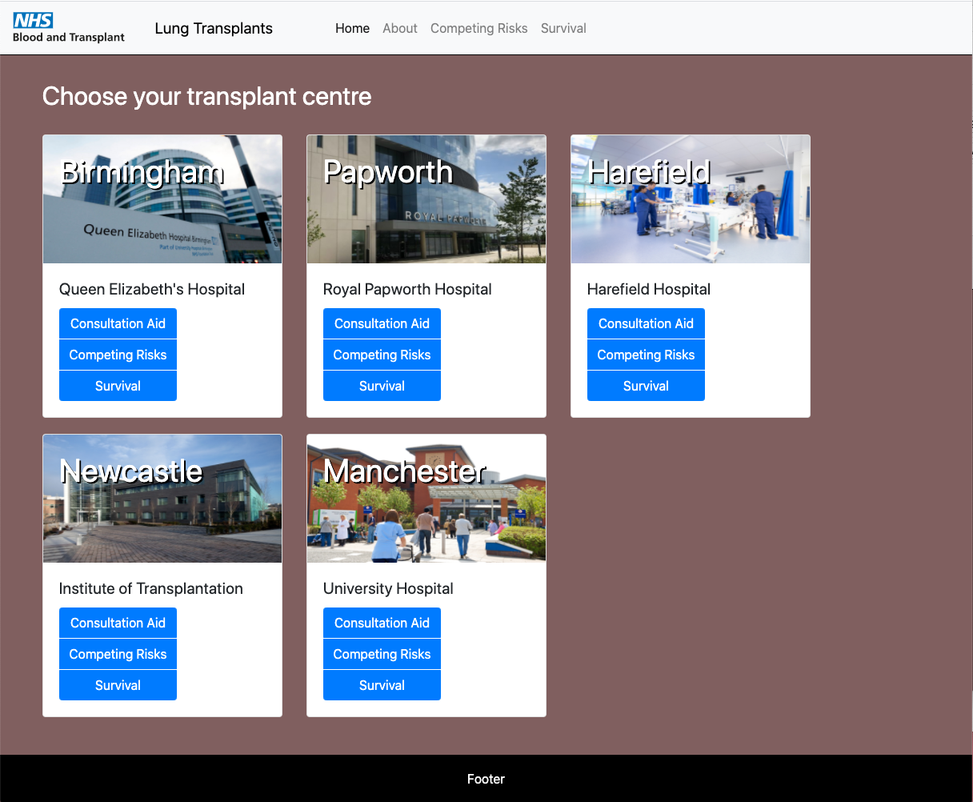
Lung Tool

Slide 4
Main tools
Competing Risks
Survival Post Transplant
Survival From Listing
Lists
What does % look like
The Window
EXAMPLES OF
donor decisions
What happens if you’re called in
What happens after xpt eg visit schedule or typical
- drug regime
WHAT DOES % LOOK LIKE
(eg to demonstrate cancer risk of meds)
ILL ENOUGH / WELL ENOUGH?
Graph of ‘the window’?

Slide 5
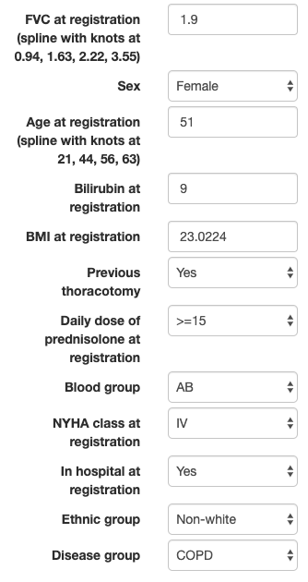
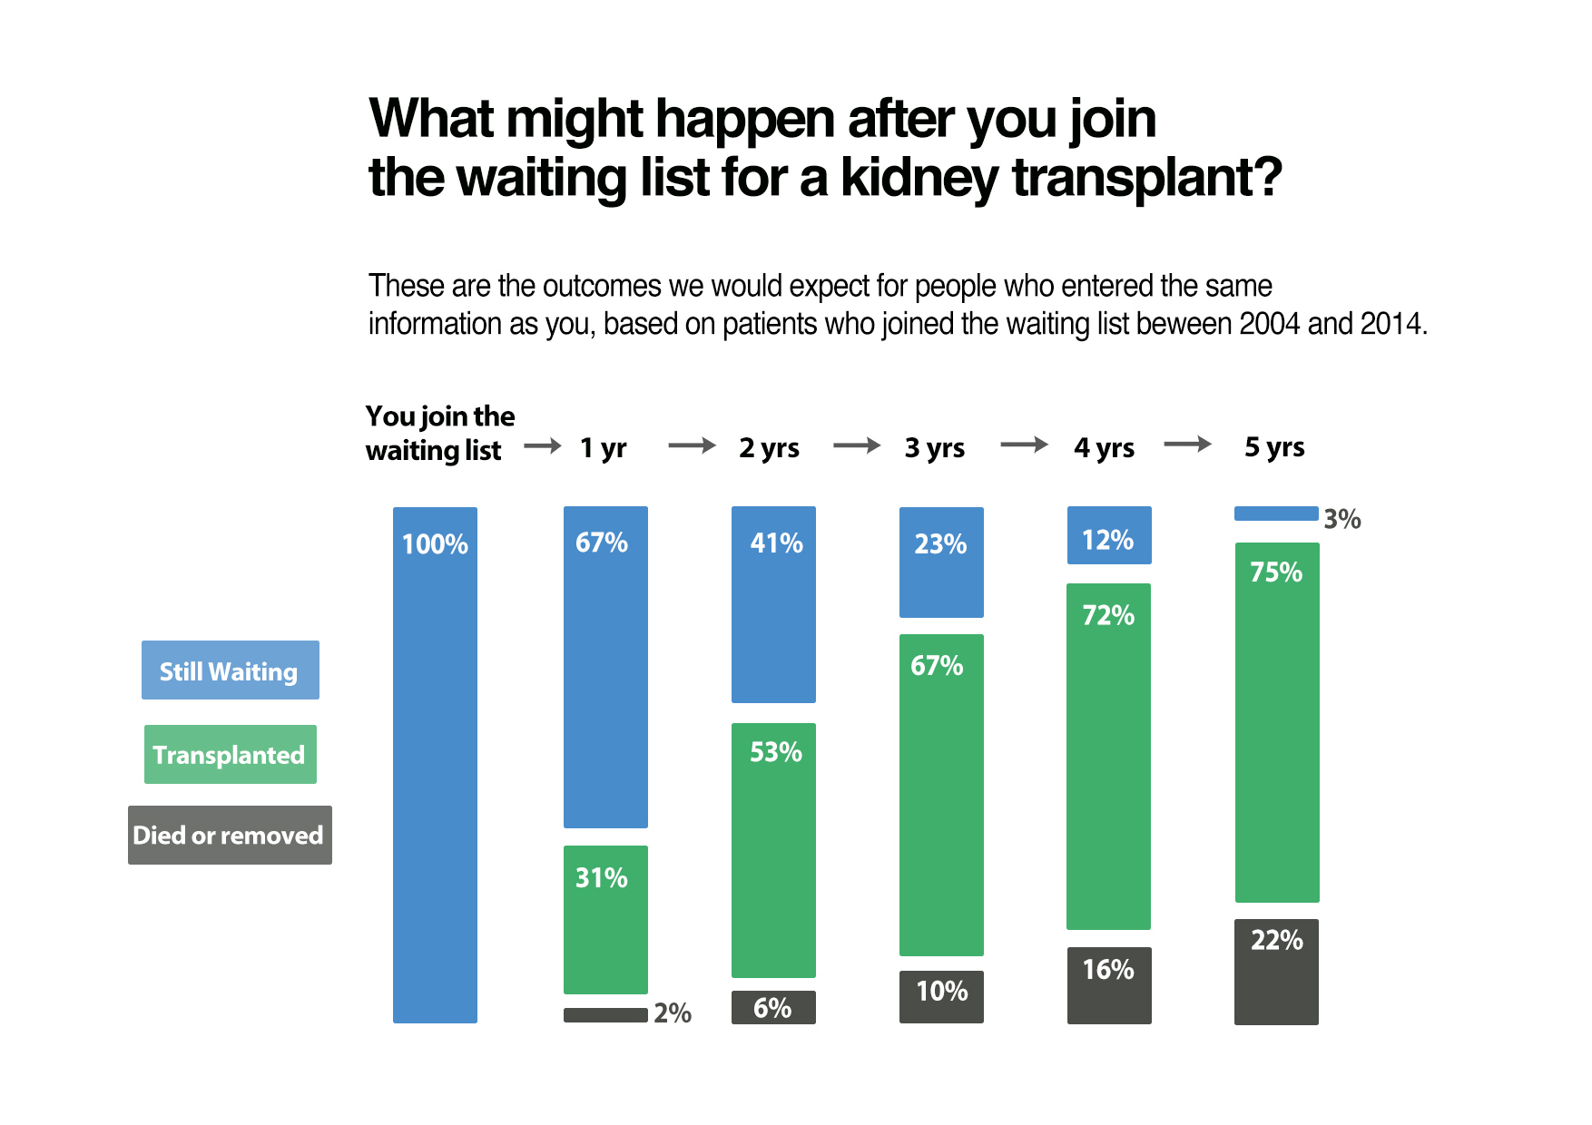
Main tools
Competing Risks
Survival Post Transplant
Survival From Listing
Lists
What does % look like
The Window
INPUT PATIENT DETAILS
OUTPUT VISUALISATIONS

Slide 6
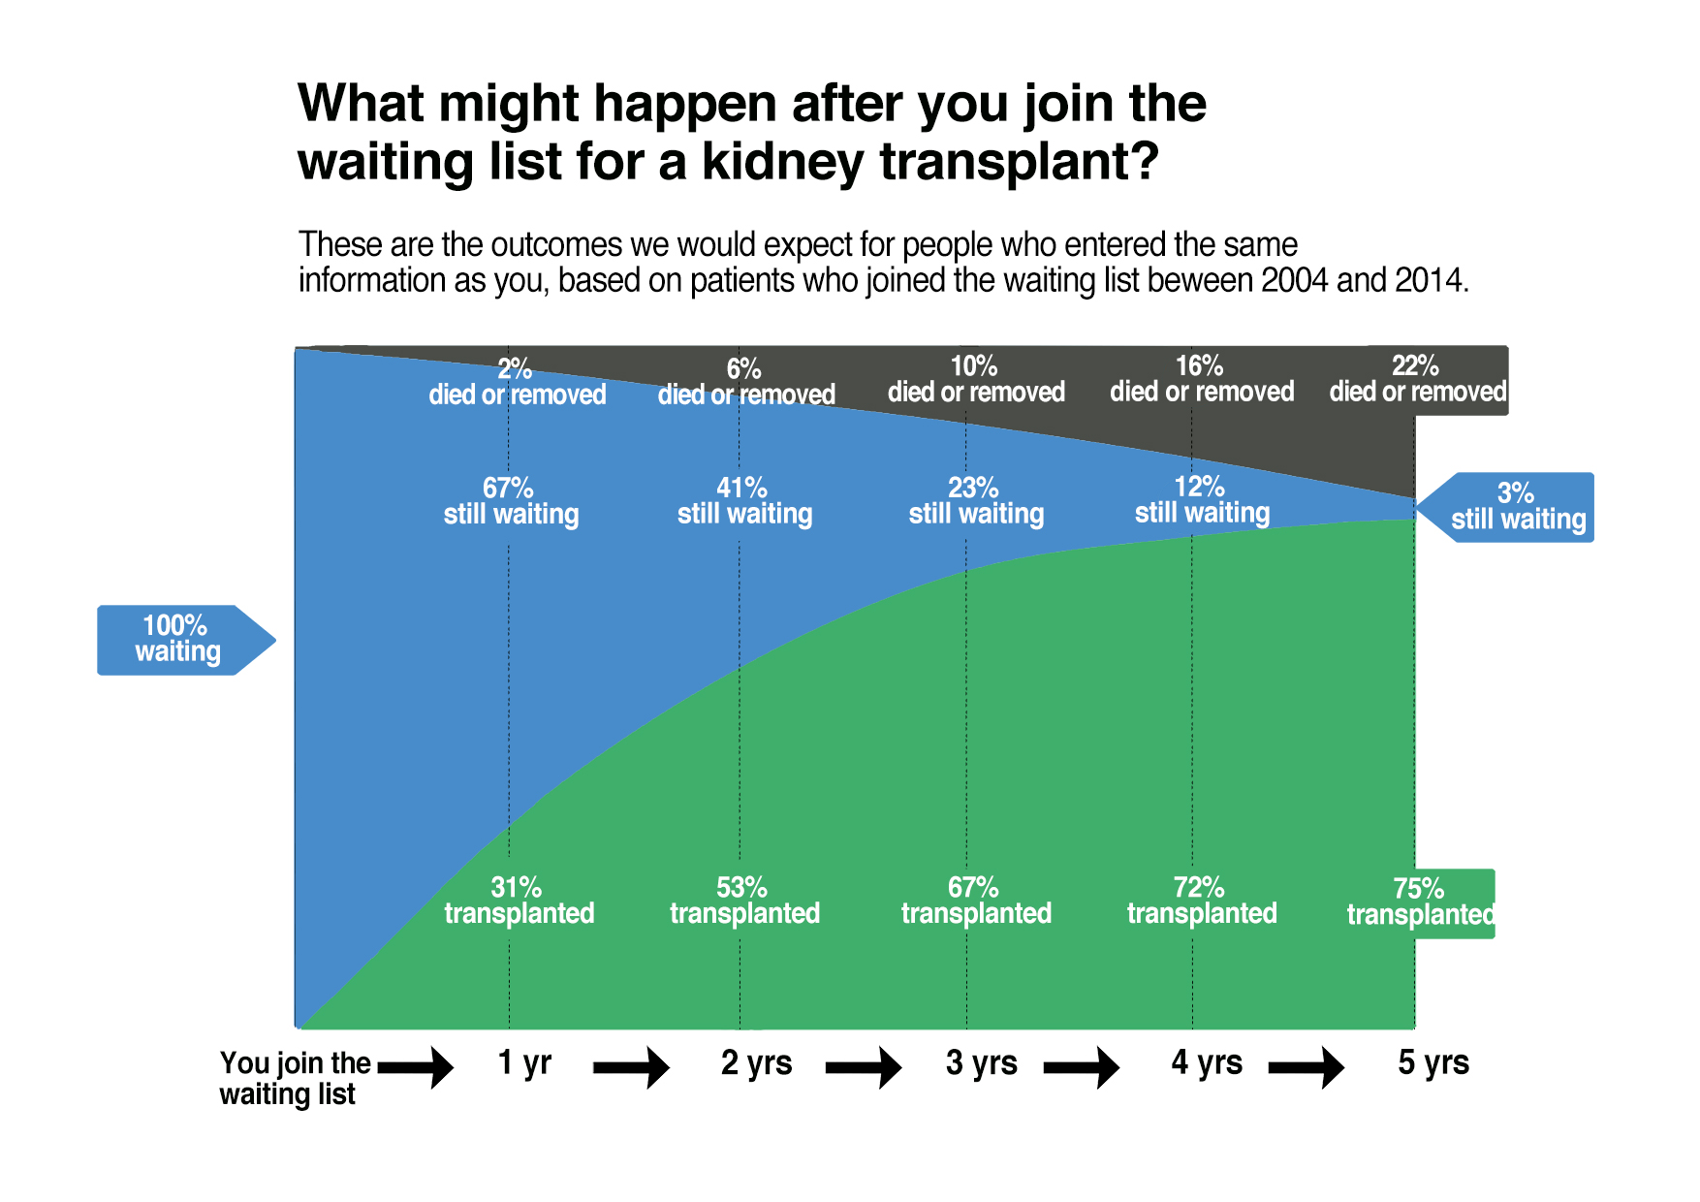
Competing Risks
Survival Post Transplant
Survival From Listing
INPUT PATIENT DETAILS
OUTPUT VISUALISATIONS

Slide 7
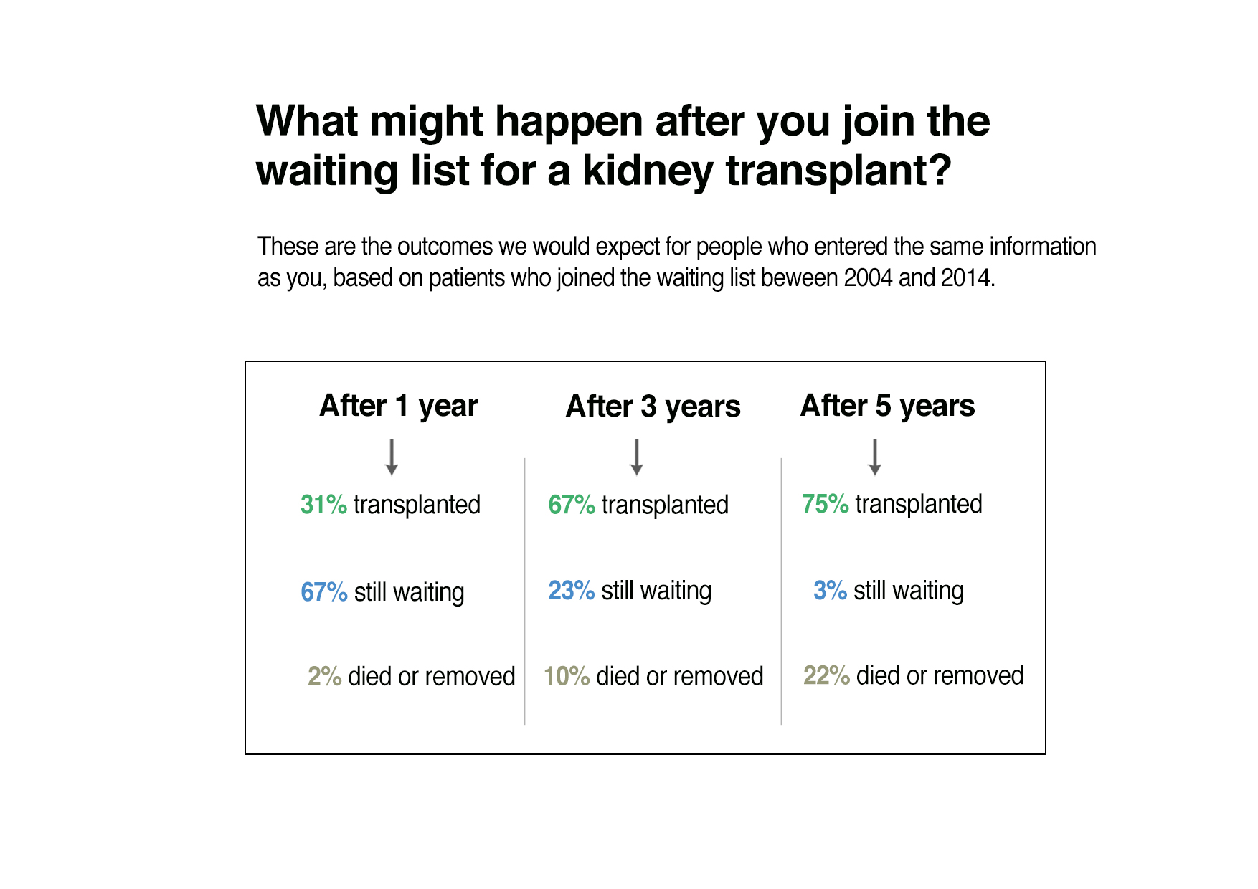
Competing Risks
Survival Post Transplant
Survival From Listing
INPUT PATIENT DETAILS
OUTPUT VISUALISATIONS

Slide 8
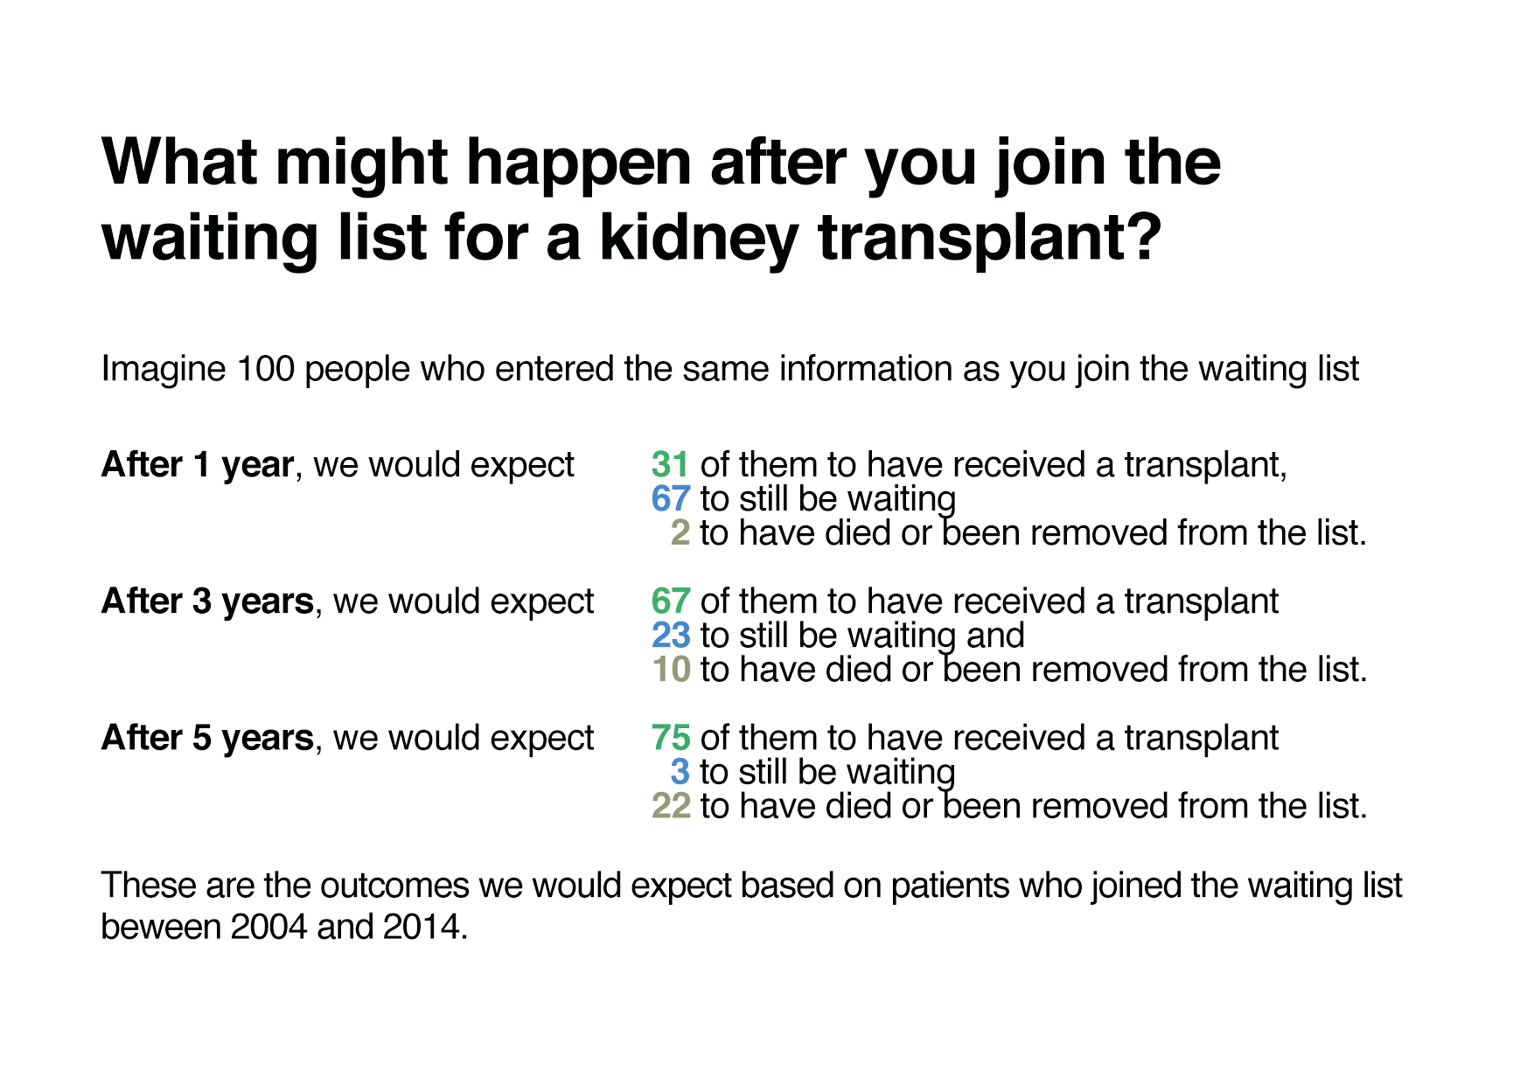
Competing Risks
Survival Post Transplant
Survival From Listing
INPUT PATIENT DETAILS
OUTPUT VISUALISATIONS

Slide 9
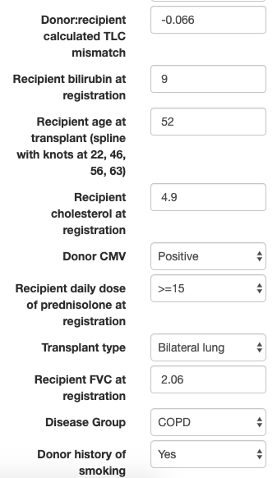
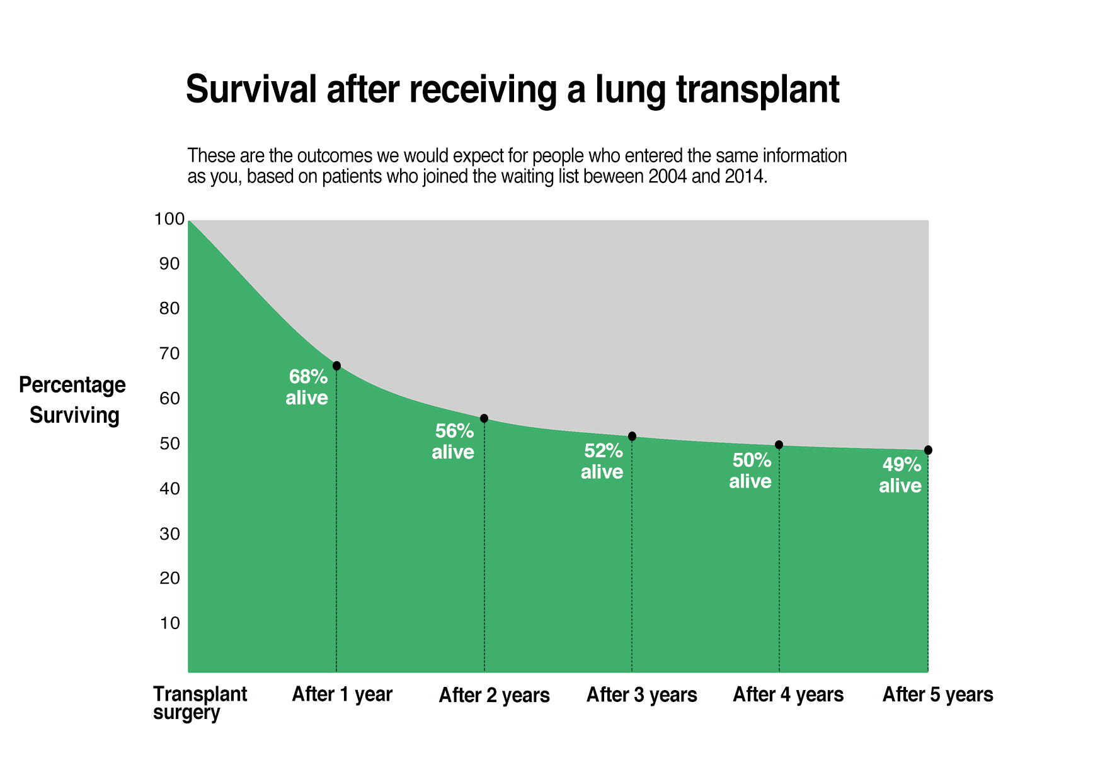
Main tools
Competing Risks
Survival Post Transplant
Survival From Listing
Lists
What does % look like
The Window
INPUT PATIENT DETAILS
OUTPUT VISUALISATIONS

Slide 10
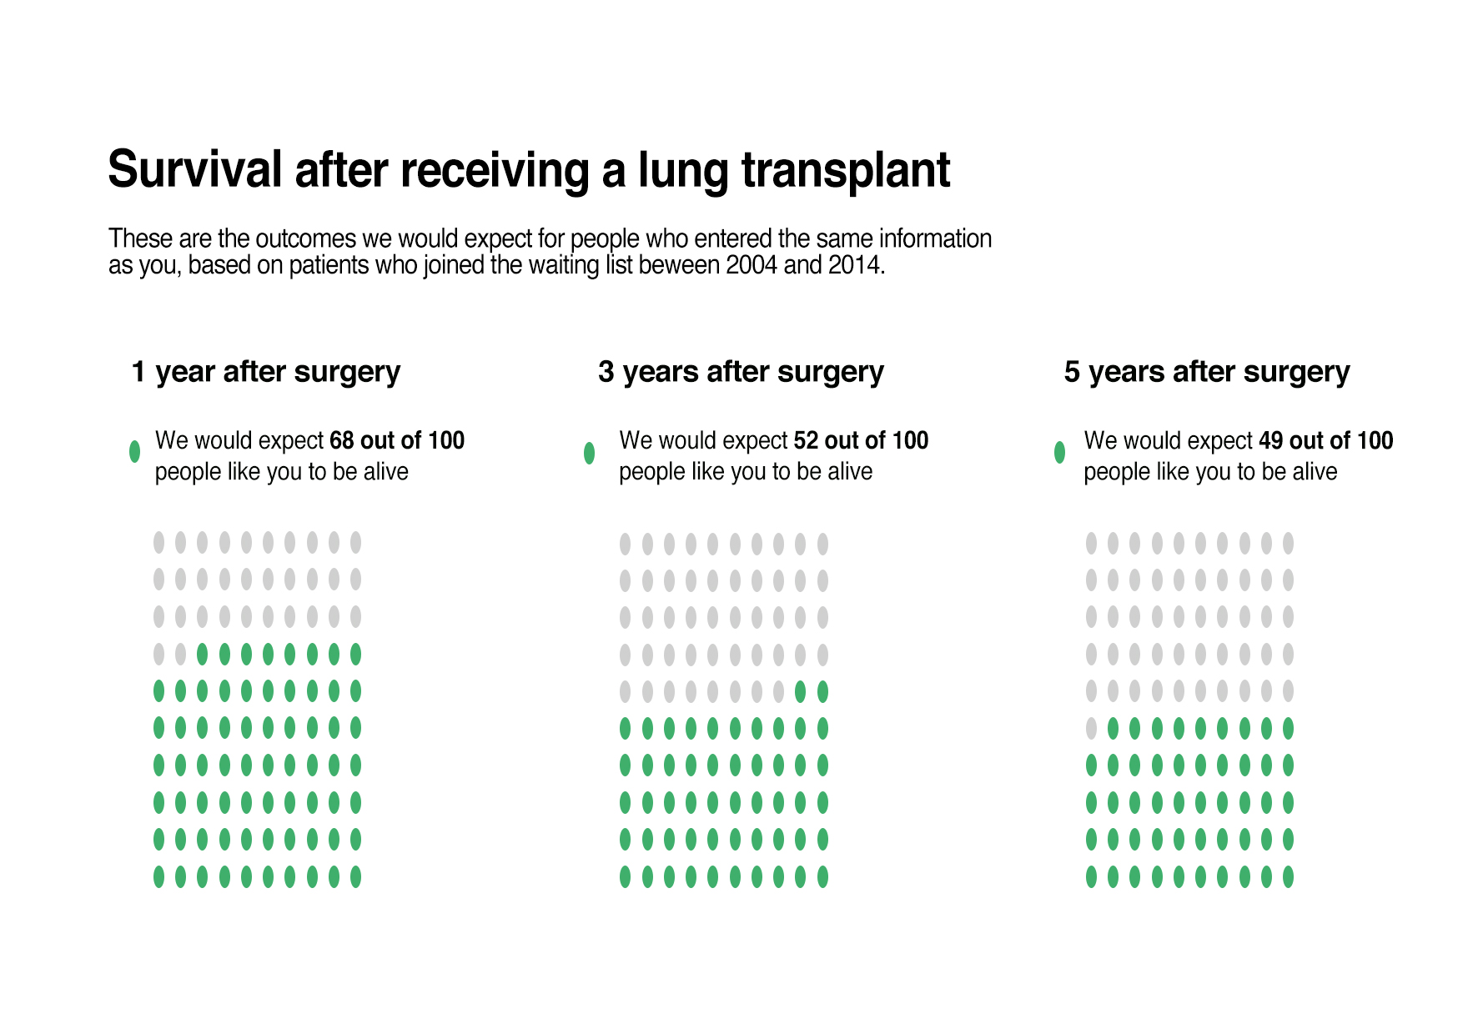
Competing Risks
Survival Post Transplant
Survival From Listing
INPUT PATIENT DETAILS
OUTPUT VISUALISATIONS

Slide 11
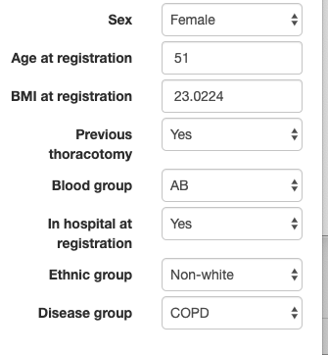
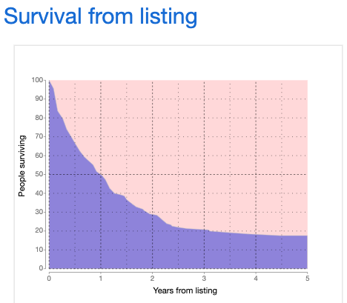
Main tools
Competing Risks
Survival Post Transplant
Survival From Listing
Lists
What does % look like
The Window
INPUT PATIENT DETAILS
OUTPUT VISUALISATIONS

Slide 12
Competing Risks
Survival Post Transplant
Survival From Listing
Lists
What does % look like
The Window
EXAMPLES OF
donor decisions
Matching criteria
What happens if you’re called in
What happens after xpt eg visit schedule or typical
- drug regime
WHAT DOES % LOOK LIKE
(eg to demonstrate cancer risk of meds)
ILL ENOUGH / WELL ENOUGH?
Graph of ‘the window’?
Graph of disease trajectory?

Slide 13
What might happen after MDT
Too well right now
Need more tests
Suitable to be listed now
Not suitable
EXAMPLE DRUG REGIME
Morning
2 x immunosuppressants
2 x progesterone
2 x xxxx
Lunch time
…..
DONOR DECISIONS
Smokers
Brain tumour
Risky Behaviour
Lists
EXAMPLES OF
donor decisions
Matching criteria
What happens if you’re called in
What happens after xpt eg visit schedule or typical
- drug regime
What might happen if I’m called in:
Phone call
Ambulance
Prep for surgery
Donor inspected
DCD / DBD
How do you match me
Blood group
Size / height
urgency
Antibodies

Slide 14
Competing Risks
Survival Post Transplant
Survival From Listing
Lists
What does % look like
The Window
WHAT DOES % LOOK LIKE
(eg to demonstrate cancer risk of meds)
EXAMPLES OF
donor decisions
Matching criteria
What happens if you’re called in
What happens after xpt eg visit schedule or typical
- drug regime
ILL ENOUGH / WELL ENOUGH?
Graph of ‘the window’?
Graph of disease trajectory?

Slide 15
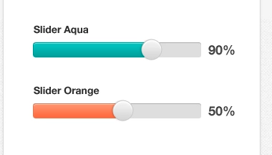
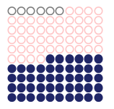
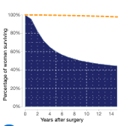
“fixed known” risks
And / Or
Slider to illustrate %
SKIN CANCER RISK ON IMMUNOSUPPRESSANTS?
6 people in 100 would normally develop skin cancer
47 people out of 100 on immunosuppressants may develop skin cancer
What does % look like
(similar to clinician.iconarray.com)
Input % of one or two conditions eg
Chance of stroke on ECMO
Or
Chance of skin cancer in general population + chance on immunosuppressants
WHAT DOES % LOOK LIKE
(eg to demonstrate cancer risk of meds)

Slide 16
Competing Risks
Survival Post Transplant
Survival From Listing
Lists
What does % look like
The Window
ILL ENOUGH / WELL ENOUGH?
Graph of ‘the window’?
Graph of disease trajectory?
EXAMPLES OF
donor decisions
Matching criteria
What happens if you’re called in
What happens after xpt eg visit schedule or typical
- drug regime
WHAT DOES % LOOK LIKE
(eg to demonstrate cancer risk of meds)

Slide 17
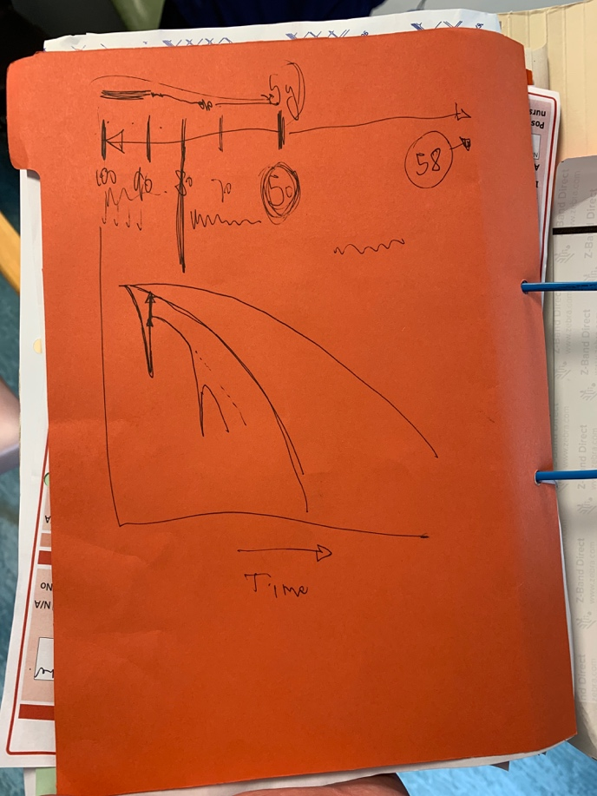
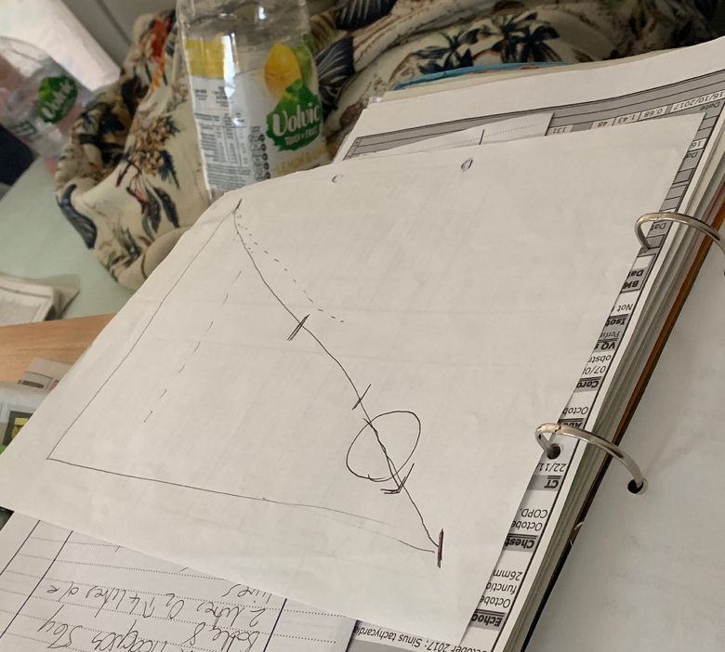
The Window
ILL ENOUGH / WELL ENOUGH?
Graph of ‘the window’?
Graph of disease trajectory?
ILL ENOUGH / WELL ENOUGH?
Graph of ‘the window’?

